Slide 1

Setting up your ML application
Bias/Variance
deeplearning.ai

Slide 2
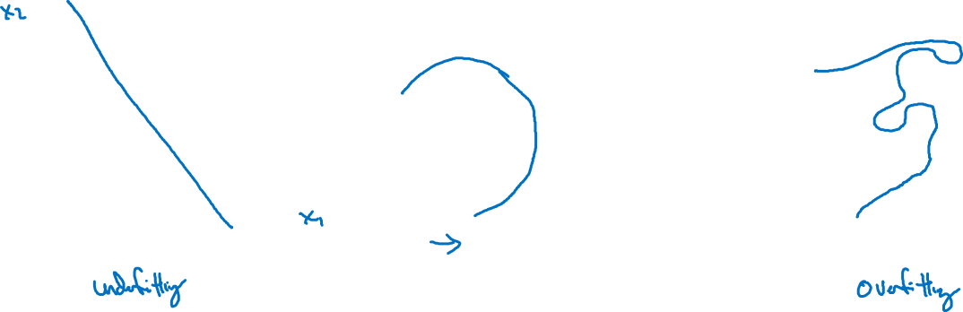
Bias and Variance
high bias
“just right”
high variance

Slide 3

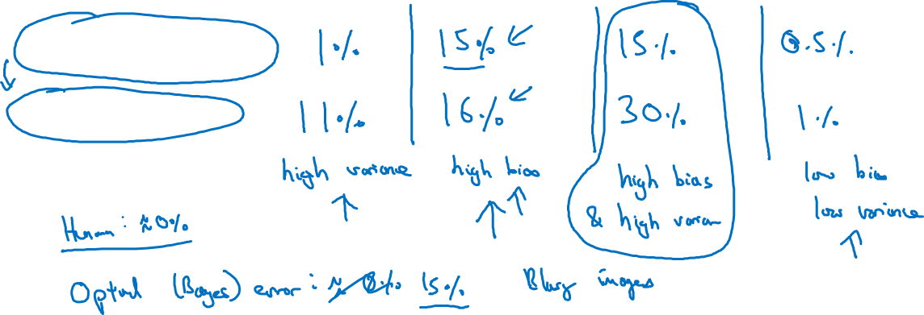
Bias and Variance
Cat classification
Train set error:
Dev set error:

Slide 4
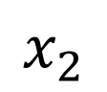
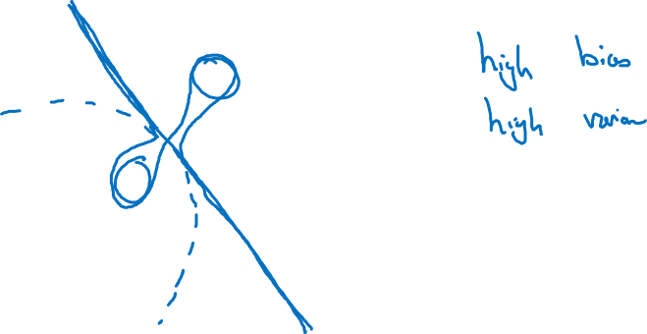
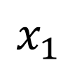
High bias and high variance

Slide 5
Setting up your ML application
Basic “recipe”
for machine learning
deeplearning.ai

Slide 6
Basic “recipe” for machine learning

Slide 7
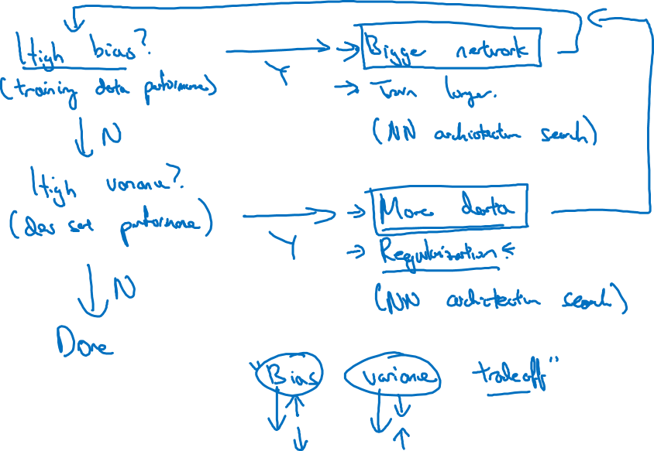
Basic recipe for machine learning

